Slide 1

What comes to your mind when you hear the word “debate”?

Slide 2
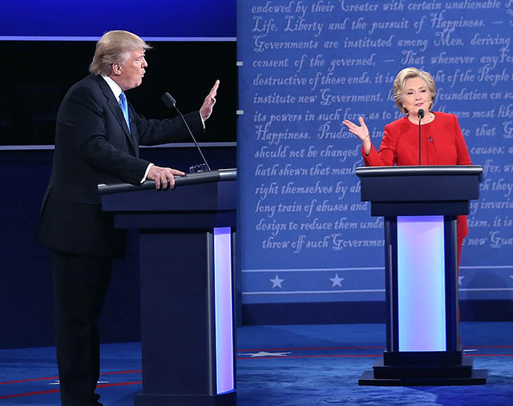

Slide 3


Slide 4

Think about the following scenarios
When you want to convince your mother to raise your pocket money
When you want to convince your parent of your choice of major in university
When you want to convince school administrators of the restaurant brand that should be introduced to our university
When you want to convince your boss to give you a pay raise

Slide 5
ENG1002 English for Academic Purposes 1
Group Discussion Activity Lecture 18

Slide 6
Agenda
Introduction to group discussion
Duties of each role
Procedures
Evaluation criteria
Grouping
First practice debate

Slide 7
Activity: Group Debate
Students will be divided into four groups of six/seven. In each group, there will be two opposing teams (For VS. Against).
Each group has 15 minutes to prepare before the debate.
Each student has one min to present their position and up to two mins in the free debate.
No AI tools are allowed for this exercise.
No digital devices are allowed during the debate.

Slide 8



Duties of Each Role
FOR
DEBATE
AGAINST

Slide 9
Duties of Each Role
Main duties
Speaker 1
Speaker 2
Speaker 3
Argument Essay
Introduction and Thesis statement
Body paragraphs Counterargument and refutation
Conclusion
Introduce the topic and present the main supporting arguments ‘for’ the statement
Further develop the supporting arguments ‘for’ the statement.
Refute the argument of the opposing side
Summarize the main arguments ‘for’.
Cell phones should be banned from the classroom

Slide 10
Procedures

Slide 11

Step 1: Introduce your position
S1 (For) introduces the topic and presents the arguments ‘for’ the statement.
S1 (Against ) comments on S 1(For)’s point and presents the arguments ‘against’ the statement
1 min
1 min
FOR
AGAINST

Slide 12
Step 2: Develop your argument
S2 (For) comments on S1(Against)’s point and further develops the argument ‘for’ the statement,
S2 (Against) Comments on S2 (For)’s point and present further arguments against the statement.
1 min
1 min
FOR
AGAINST

Slide 13
Step 3: Open debate
OPEN
DEBATE
FOR
AGAINST
12 min (6)/14 min (7)

Slide 14
Step 4: Closing arguments
S3 (For) summarizes the main arguments ‘for’.
S3 (Against)
summarizes the main arguments ‘against’.
1 min
1 min
FOR
AGAINST

Slide 15
Procedures
Speaker 1: 1 mins (‘for’ side) + 1 mins (‘against’ side)
Speaker 2: 1 mins (‘for’ side) + 1 mins (‘against’ side)
Free debate: 12-14 mins
Speaker 3: 1 mins (‘for’ side) + 1 mins (‘against’ side)

Slide 16
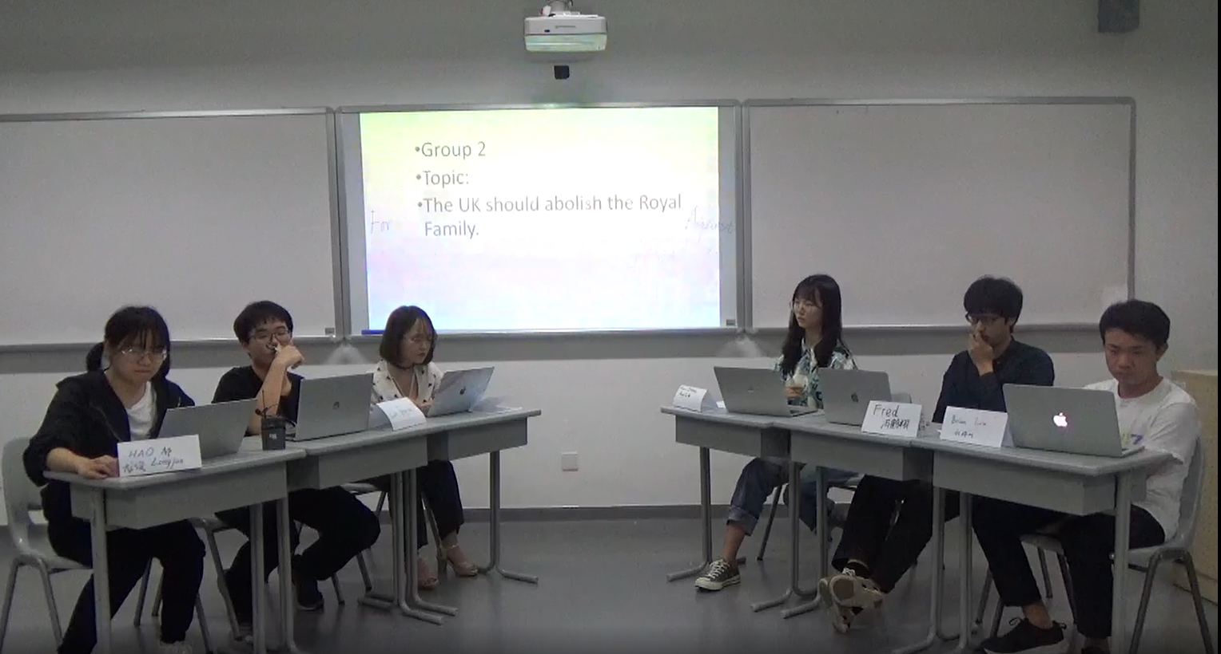
Sample Group Discussion
Notes:
https://bb.cuhk.edu.cn/webapps/blackboard/content/listContentEditable.jsp?content_id=_413325_1&course_id=_11604_1

Slide 17
Evaluation
Each student will be given an individual grade
Content: | Delivery& language
On topic Presents ideas clearly with support Demonstrates subject knowledge Persuasiveness Interacts with others (+/-) Uses time effectively | Fluency Body language (e.g. gestures, posture), Pronunciation (clarity), use of intonation and stress, effective use of pauses, volume, speed of speech Accuracy, appropriateness, variety and complexity of vocabulary & grammar Effective use of discussion language (for example interrupting, agreeing, disagreeing, etc.)

Slide 18
What can you do during the preparation time as a debater?

Slide 19
During your preparation
1. Begin with individual brainstorming about both your own team’s arguments and gather evidence for your position (5 mins).
2. Spend a few minutes exchanging your ideas within your team and discussing internally to refine and strengthen your arguments.
3. Gather and organize all of your arguments (this can be the responsibility of debater #1) and split the tasks if needed.
4. If time allows, allocate time to anticipate and prepare responses to opponents' strongest counter-arguments.

Slide 20
What can you do during the preparation time as an audience member?

Slide 21
Audience role
vote ‘for’ or ‘against’
research the topic while teams are preparing
ask “ambush” questions after the debate
contribute your own thoughts and opinions on the arguments presented
Task sheet of the audience

Slide 22

Three things to decide
1. Group
2. Team
(Side)
3. Role on each team

Slide 23
Tentative group presentation schedule
Date | Group
April 1/2 | Group 1
April 3/4 | Group 2
April 8/9 | Group 3
April 10/11 | Group 4
April 15/16 | Group 1,2,3,4
April 17/18 | Group 1,2,3,4
April 22/23 | Group 1&2 (Graded)
April 24/25 | Group 3&4 (Graded)

Slide 24
A sample of discussion language

Slide 25
Managing the discussion
Beginning the discussion
Let’s look at the first point.
Perhaps we could begin by talking about…
Stating the goal
The main aim of the discussion is to…
The purpose of this discussion is to…
Moving to other points
Let’s move on to the next point.
Why don’t we look at the next option?

Slide 26
Managing the discussion-Cont.
Keeping the discussion on-topic
I think we are getting away from the issue here.
Summarizing
OK, I think that covers everything, don’t you?
Right, let’s go over it again.

Slide 27
Giving your ideas and opinions
Taking the floor / Interrupting
Hold on a moment.
May I say something?
Holding the floor
Could I just finish…?
Well, let me explain
Giving Opinions
I strongly/firmly believe…
In my view…

Slide 28
Giving your ideas and opinions
Giving reasons
I think …. we should … because…
That’s why I feel that…
Making suggestions
Perhaps we should…
We could….
Persuading (Negotiating for inclusion of ideas)
This is the best way to…. because…
While these are good ideas, the most effective method is….

Slide 29
Encouraging Others and Commenting
Handing over to others /Asking for opinions
What do you think?
How do you feel about this?
Asking for reasons
Why do you think that…?
What makes you feel that…?
Clarifying
What do you mean by….?
Sorry, I don’t quite understand.
•

Slide 30
Encouraging Others and Commenting
Agreeing
I think you’re right.
I agree with you (her / him / …)
Disagreeing
I’m not sure about that idea.
I’m afraid I don’t agree.

